Slide 1

Fruits
Livre de Coloriage

Slide 2


Tracer & Colorer
Fruits
Banane

Slide 3
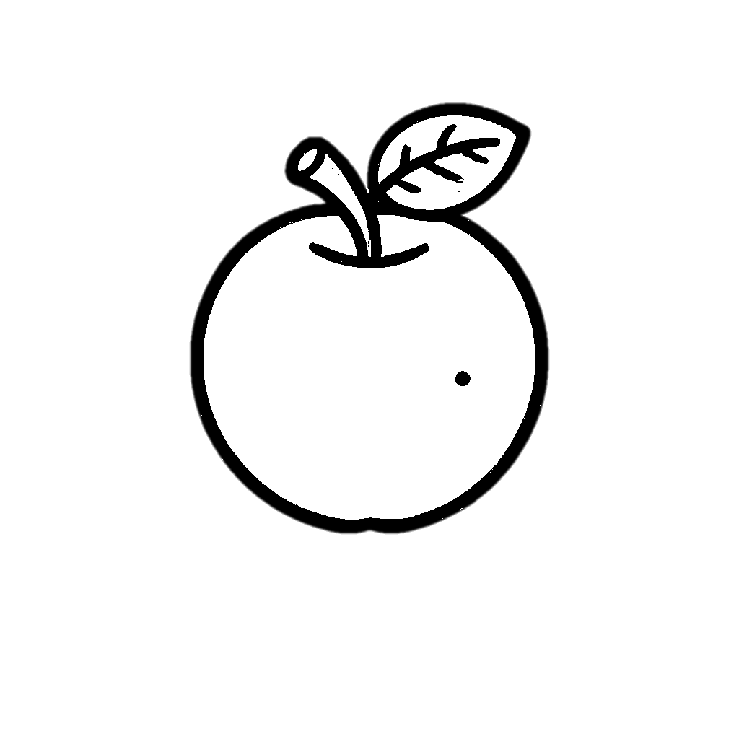

Tracer & Colorer
Fruits
Pomme

Slide 4


Tracer & Colorer
Fruits
Ananas

Slide 5


Tracer & Colorer
Fruits
Cerise

Slide 6


Tracer & Colorer
Fruits
Raisins

Slide 7


Tracer & Colorer
Fruits
Orange

Slide 8
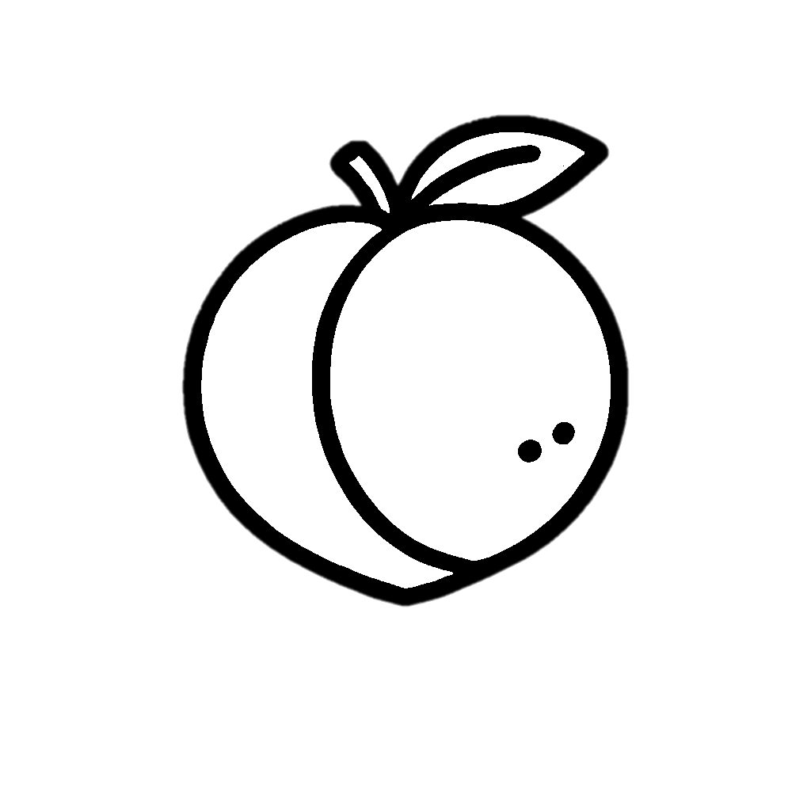

Tracer & Colorer
Fruits
Pêche

Slide 9


Tracer & Colorer
Fruits
Mangue

Slide 10


Tracer & Colorer
Fruits
Prune

Slide 11
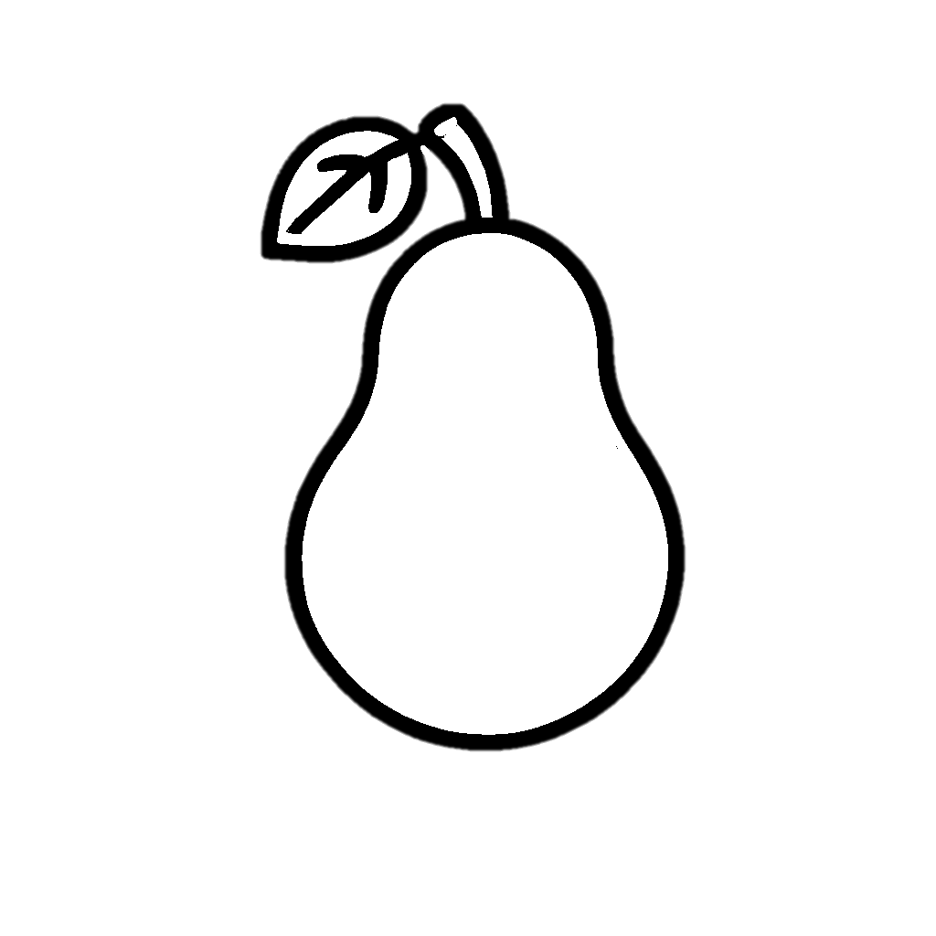

Tracer & Colorer
Fruits
Poire

Slide 12


Tracer & Colorer
Fruits
Fraise

Slide 13


Tracer & Colorer
Pastèque
Fruits

Slide 14


Tracer & Colorer
Fruits
Avocat

Slide 15


Tracer & Colorer
Fruits
Grenade

Slide 16


Tracer & Colorer
Fruits
Papaye

Slide 17


Tracer & Colorer
Fruits
Goyave

Slide 18

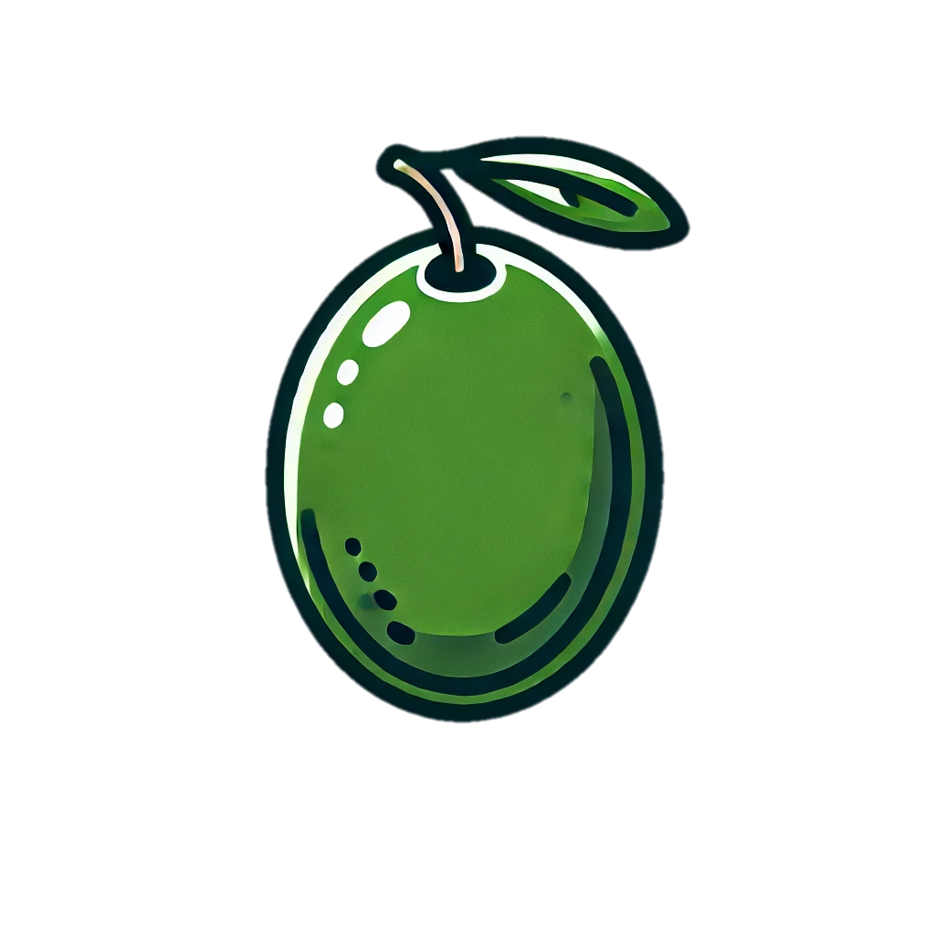
Tracer & Colorer
Fruits
Olive

Slide 19


Tracer & Colorer
Fruits
Figue

Slide 20


Tracer & Colorer
Fruits
Datte

